Slide 1



ARRÊT CARDIAQUE EXTRAHOSPITALIER
QUELLES QUESTIONS POUR DEMAIN ?
Matthieu HEIDET
SAMU 94 & SAU Mondor
Université Paris-Est Créteil

Slide 2

POURQUOI SE POSER DES QUESTIONS ?

Slide 3


FRANCE
50 000 cas / an
55 / 100 000 habitants
Greif R, Lauridsen KG, Djärv T et al. European Resuscitation Council Guidelines 2025 Executive Summary. Resuscitation. 2025 Oct;215 Suppl 1:110770.

Slide 4

MCE PAR TÉMOINS 58 %
Nishiyama C et al. Resuscitation 2023;186:109757

Slide 5
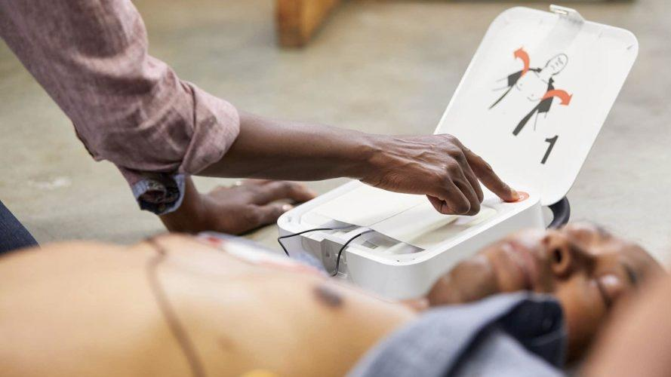
2 - 59 %
Nishiyama C et al. Resuscitation 2023;186:109757

Slide 6

SURVIE
3 - 35 %
Greif R, Lauridsen KG, Djärv T et al. European Resuscitation Council Guidelines 2025 Executive Summary. Resuscitation. 2025 Oct;215 Suppl 1:110770.

Slide 7
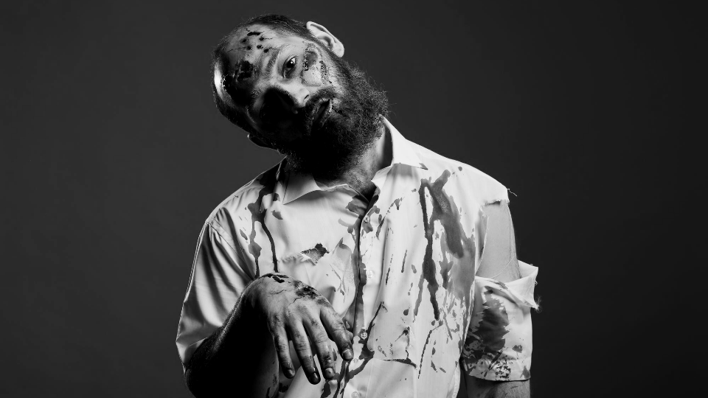
CPC > 2
50 %
Greif R, Lauridsen KG, Djärv T et al. European Resuscitation Council Guidelines 2025 Executive Summary. Resuscitation. 2025 Oct;215 Suppl 1:110770.

Slide 8


Slide 9
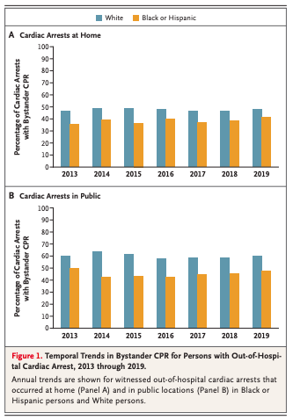
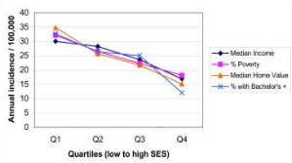

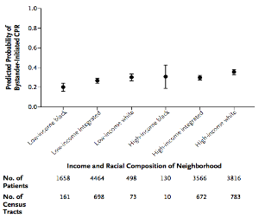
Chugh et al. Epidemiology of sudden cardiac death: clinical and research implications. Prog Cardiovasc Dis. 2008 Nov-Dec;51(3):213-28

Slide 10

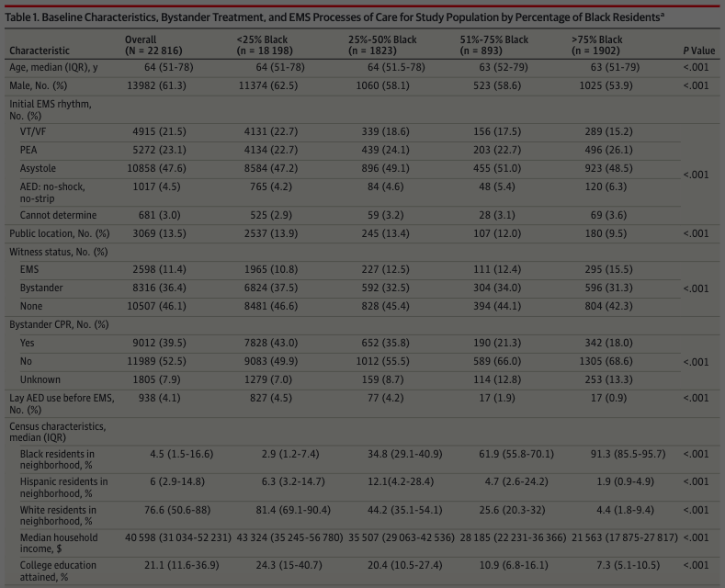
Défavorisation socioéconomique
=
Moins de RCP
Moins de DAE
Moins bon pronostic

Slide 11


Slide 12
QUAND SE POSER DES QUESTIONS ?

Slide 13


Slide 14
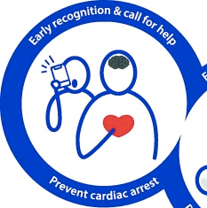

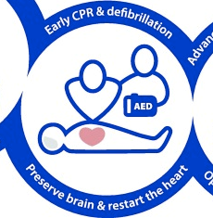
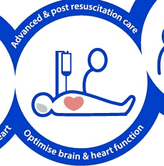

Slide 15
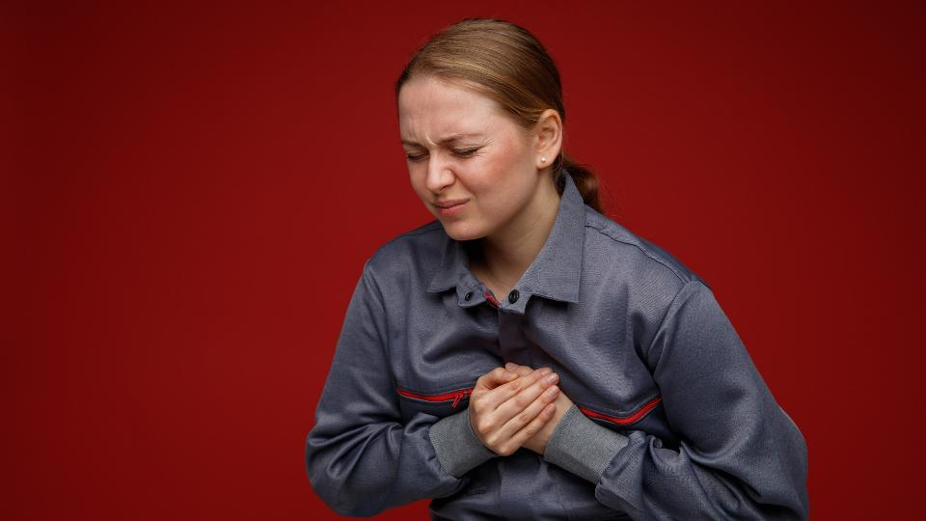





Slide 16


Slide 17

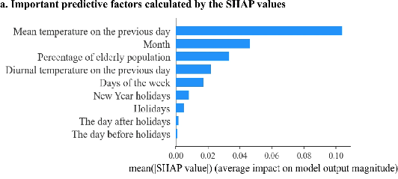

Slide 18
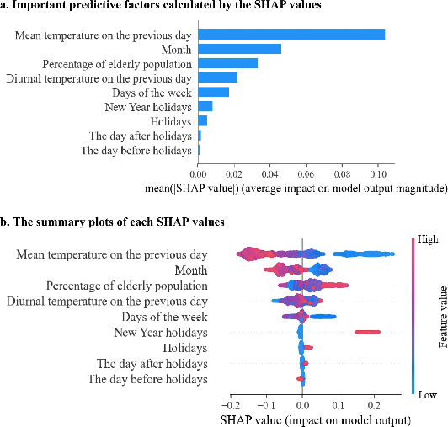

Slide 19

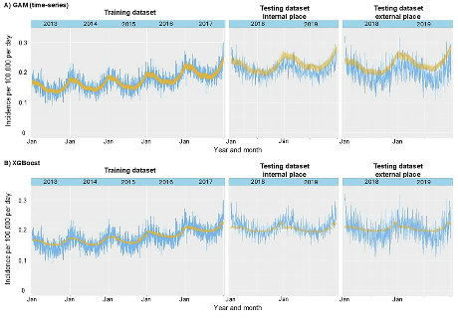
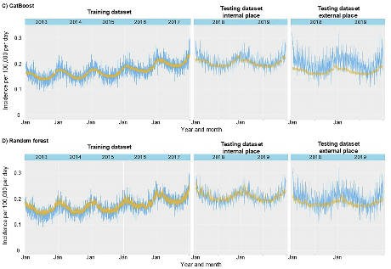

Slide 20

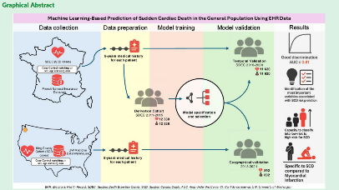
Notes:
This study developed a machine learning model that uses medical records to help identify people in the general population who may be at high risk of sudden cardiac death, even if they have no known heart disease. • Key finding 1: The model accurately predicted sudden cardiac death using electronic health records up to 5 years before the event, even when traditional heart disease warning signs were absent in over 25% of cases. • Key finding 2: When tested on populations in Paris and Seattle, the model successfully identified 26–33% of all sudden cardiac death cases within the highest-risk group, showing promise as a future screening tool. This study developed a machine learning model that uses medical records to help identify people in the general population who may be at high risk of sudden cardiac death, even if they have no known heart disease. • Key finding 1: The model accurately predicted sudden cardiac death using electronic health records up to 5 years before the event, even when traditional heart disease warning signs were absent in over 25% of cases. • Key finding 2: When tested on populations in Paris and Seattle, the model successfully identified 26–33% of all sudden cardiac death cases within the highest-risk group, showing promise as a future screening tool.

Slide 21
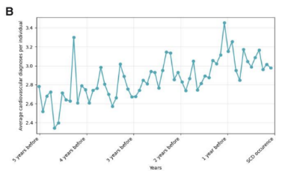
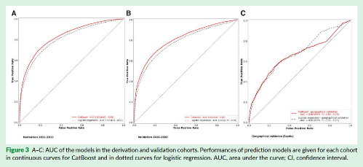
Notes:
This study developed a machine learning model that uses medical records to help identify people in the general population who may be at high risk of sudden cardiac death, even if they have no known heart disease. • Key finding 1: The model accurately predicted sudden cardiac death using electronic health records up to 5 years before the event, even when traditional heart disease warning signs were absent in over 25% of cases. • Key finding 2: When tested on populations in Paris and Seattle, the model successfully identified 26–33% of all sudden cardiac death cases within the highest-risk group, showing promise as a future screening tool. This study developed a machine learning model that uses medical records to help identify people in the general population who may be at high risk of sudden cardiac death, even if they have no known heart disease. • Key finding 1: The model accurately predicted sudden cardiac death using electronic health records up to 5 years before the event, even when traditional heart disease warning signs were absent in over 25% of cases. • Key finding 2: When tested on populations in Paris and Seattle, the model successfully identified 26–33% of all sudden cardiac death cases within the highest-risk group, showing promise as a future screening tool.

Slide 22


Slide 23


Slide 24
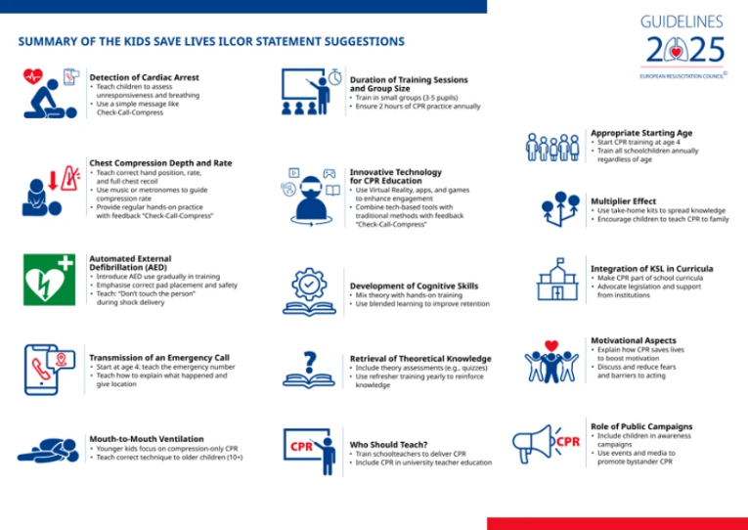

Slide 25
DES GASPS OU UN GROS DODO ?

Slide 26


Slide 27

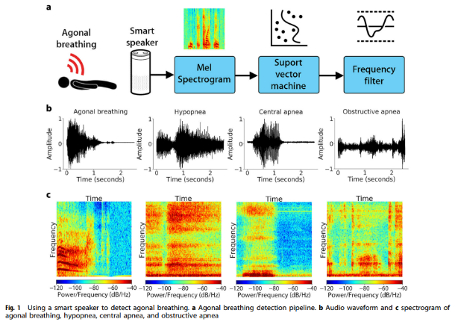

Slide 28
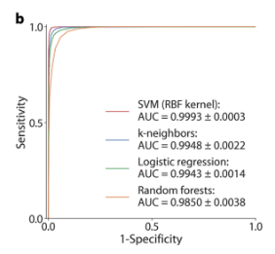
1

Slide 29
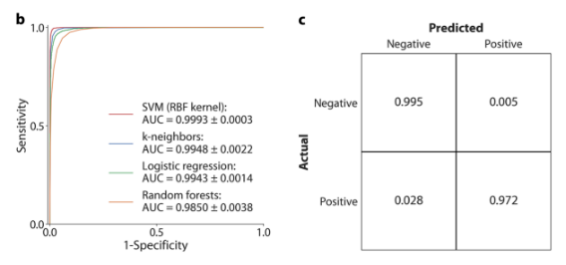

Slide 30
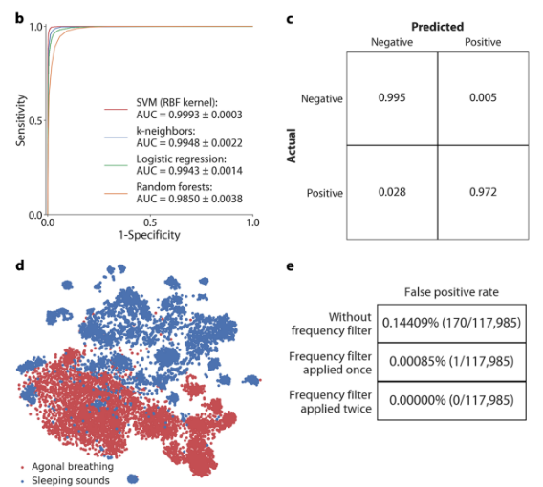

Slide 32


Slide 33
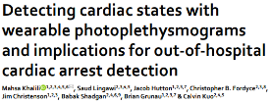
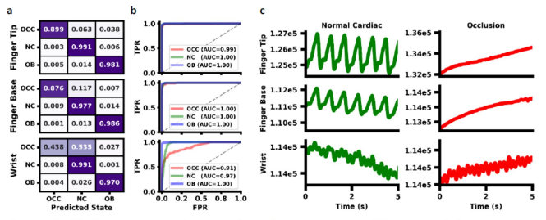

Slide 34


Slide 35
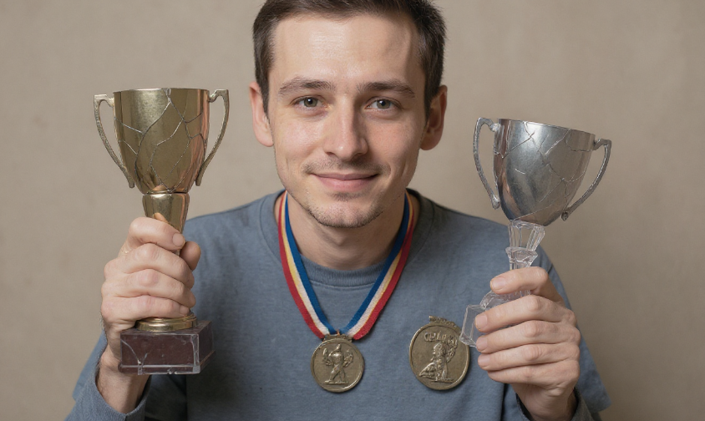


Slide 36
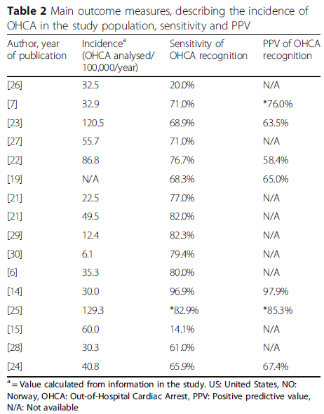
Se 14 - 97 %
VPP 58 - 98 %

Slide 37



Slide 38
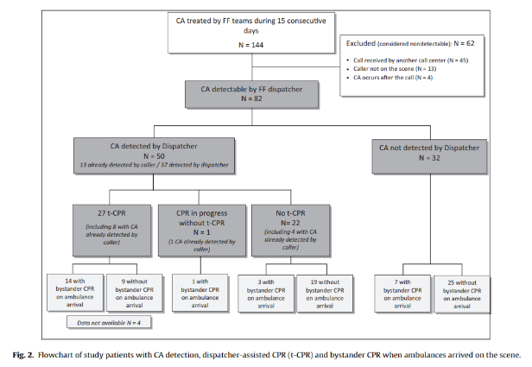

Slide 39
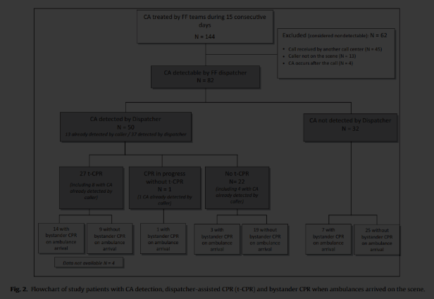

Taux détection
61 %

Slide 40
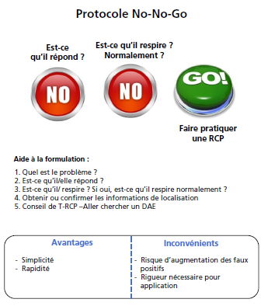
Notes:
J’ai le choix entre deux algorithmes : l’un très sensible, donc à risque d’augmenter les faux positifs, le NO-NO-GO

Slide 41
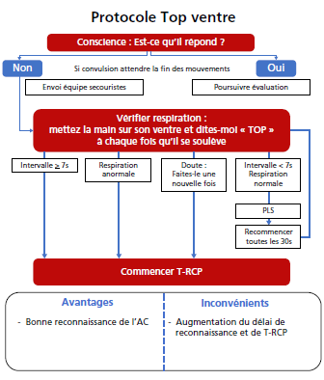
Notes:
Et l’autre plus spécifique, donc à risque de faux négatifs, et surtout un peu plus long que le NO NO GO

Slide 42

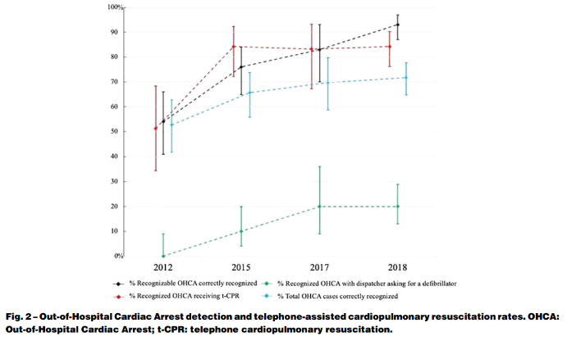

93%

Slide 43


Slide 44

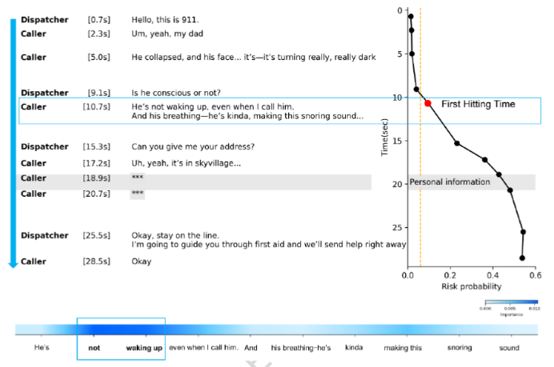

Slide 45
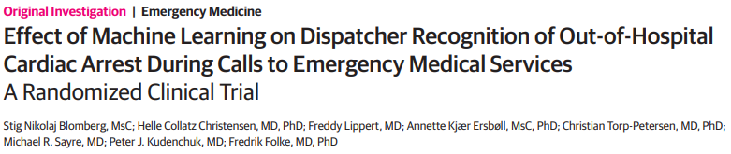

Slide 46


Slide 47
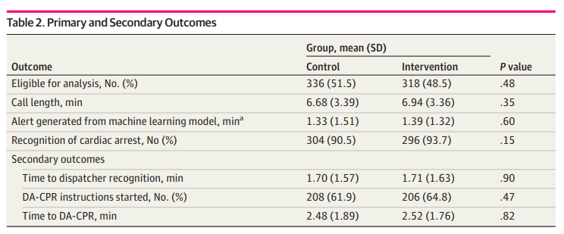
NS

Slide 48

Oui mais…
90 %

Slide 49
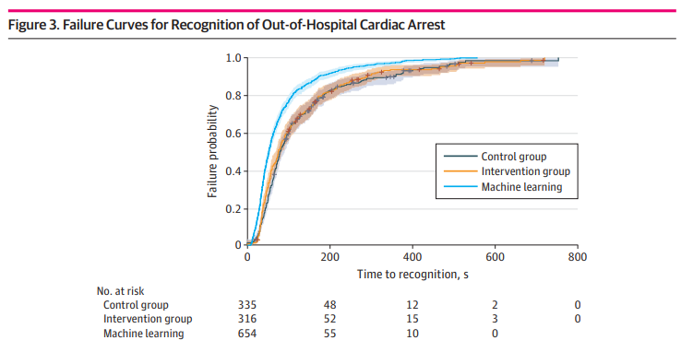
Et aussi…

Slide 50
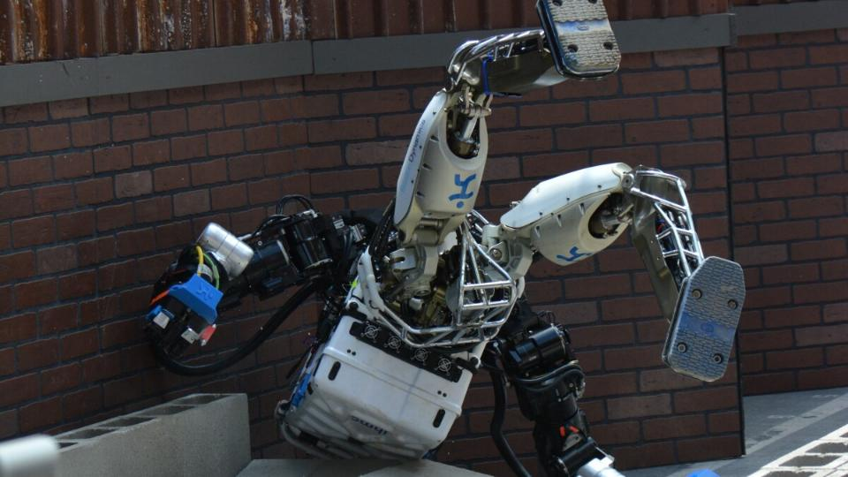

Slide 51


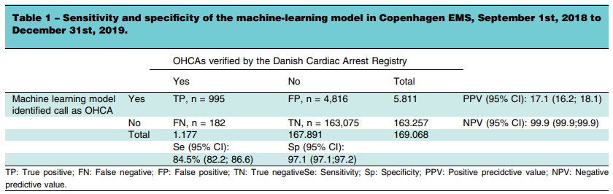

Slide 52
CHEZ LES FAUX NÉGATIFS
AUTRE MOTIF RAPPORTÉ 32 %
RESPIRATION “NORMALE” 28 %
BARRIÈRE LANGUE 23 %
CHEZ LES FAUX POSITIFS
MORT CERTAINE 13 %

Slide 53
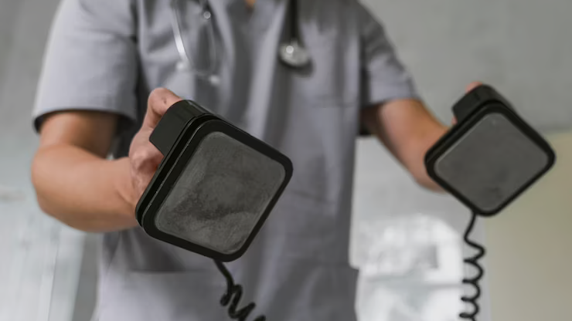





Slide 54

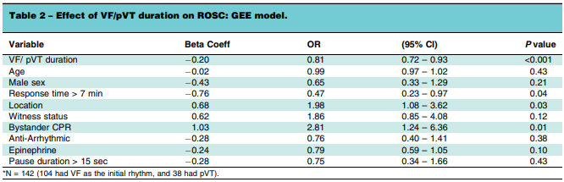
1 minute =
-20% RACS

Slide 55
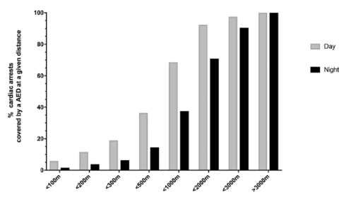
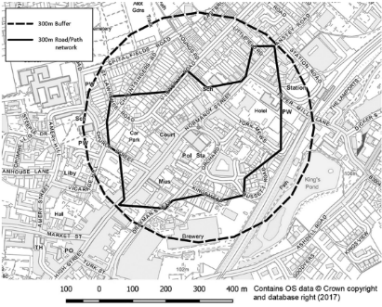

Euclidienne
Réseau
< 20 %
Deakin CD, Anfield S, Hodgetts GA. Heart 2018;104:1339–1343

Slide 56
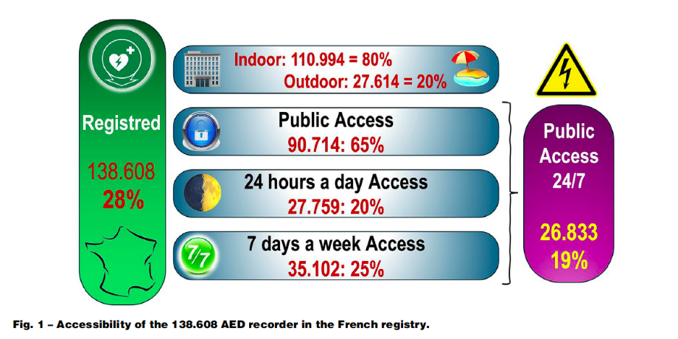
Thomas-Lamotte B, Benameur N, Soulat L, Petrovic T, Lapostolle F. Resuscitation. 2025 Feb;207:110502.

Slide 57
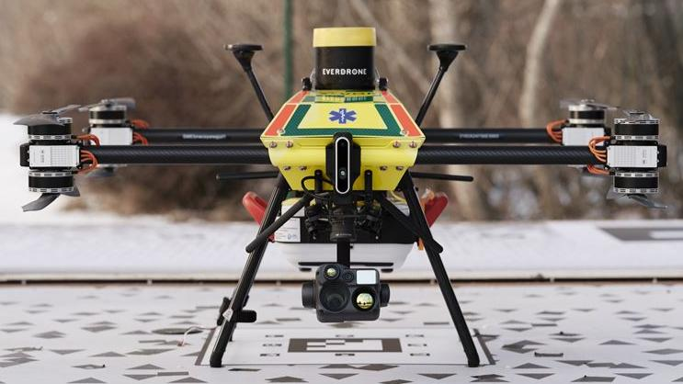


Slide 58

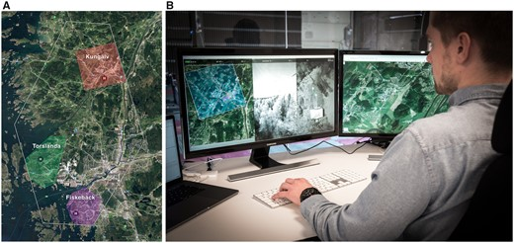

Slide 59

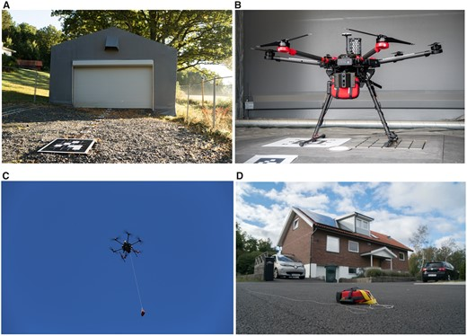

Slide 60
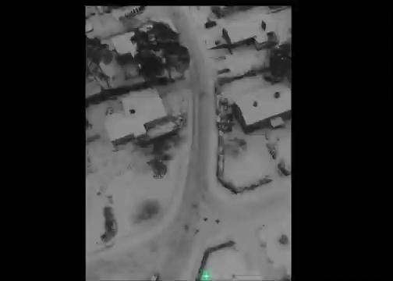

Slide 61
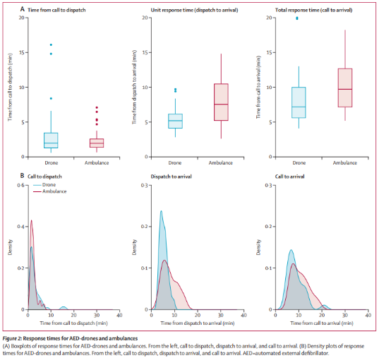


Slide 62
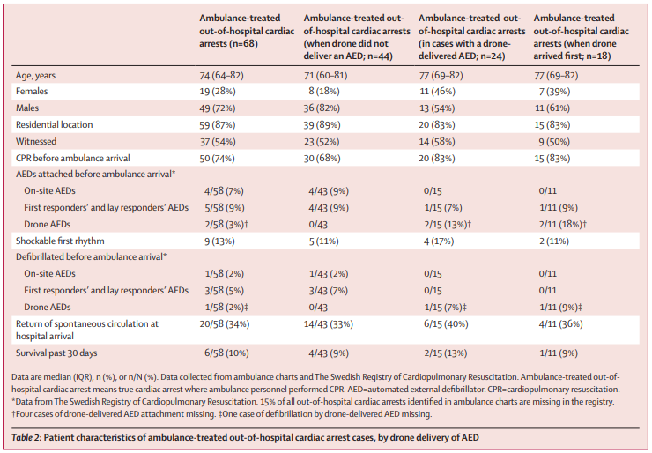

Slide 63
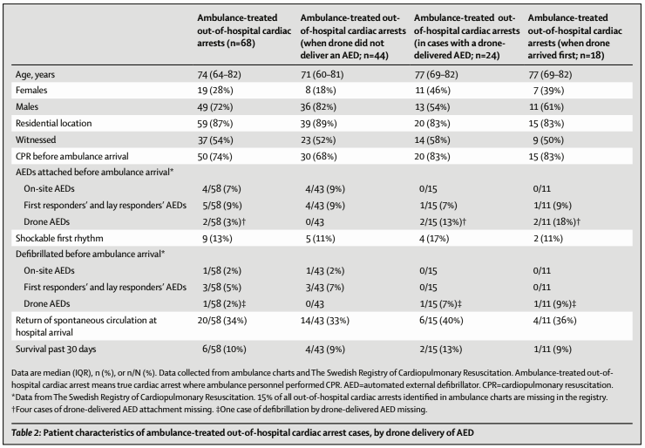


TAUX D’APPLICATION
x 2.5

Slide 64


TAUX DE CEE
x 4.5

Slide 65


Slide 66
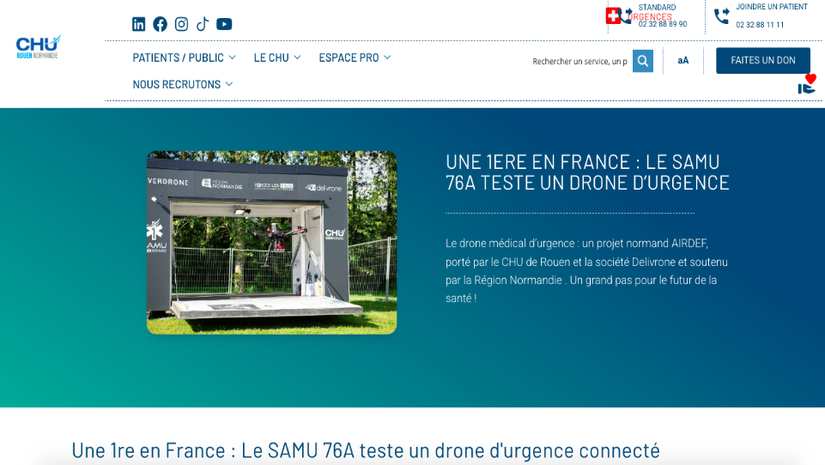
ROUEN

Slide 67



Slide 68




Slide 69



Slide 70




TV / FV RÉFRACTAIRE
(> 3 CEE)

Slide 71




?

Slide 72



?

Slide 73

Notes:
Défibrillateurs intelligents

Slide 74

50% FV RÉCIDIVENT…
DONT 75% EN < 120 S !
10.1016/S0300-9572(03)00208-9

Slide 75

EN PER-RCP
Quelle est la FV ?

Slide 76


Slide 77

ALGORITHME D’ANALYSE PER-RCP
ClinicalTrials.gov Identifier: NCT04691089

Slide 78


Slide 79



Slide 80


Arrivée avant EMS 70 %
DSA avant EMS 3 %

Slide 81


Slide 82


Slide 83


Slide 84



Singapour
2 ans
4088 activations
374 acceptations (9%)
127 arrivés avant EMS (34%)
Délai activation - arrivée = 7 minutes

Slide 85





Notes:
2) les secouristes ne défibrillent pas assez vite

Slide 86


L'ÉCHOGRAPHIE SAUVE-T-ELLE LES PATIENTS EN ARRÊT CARDIAQUE ?

Slide 87

NON.

Slide 88







Slide 89


Slide 90


RACS
SURVIE

Slide 91


Pronostic

Slide 92


Skilled operators
Interruptions
RV dilation should not be used
Not for TOR

Slide 93


Slide 94




Slide 95

ADRÉNALINE ?

Slide 96



Survie à J30
CPC

Slide 97





Slide 98
DÉLAI D'INTRODUCTION ?
(VOIE ?)
INTERVALLE ?
DOSE ?

Slide 99



ADRÉNALINE

Slide 100

10 min

Slide 101
5 min

Slide 102



Notes:
24 simulations
The kit contains personal protective equipment (gloves, surgical face mask); automated external defibrillator (AED); CPR breathing mask; epinephrine auto-injector; Intranasal (IN) naloxone; Tourniquet; Hemostatic gauze; gauze roll; albuterol inhaler; Intranasal glucagon; chewable aspirin; Pulse oximeter; Trauma shears; Razor; tape.

Slide 103


Slide 104




Slide 105


Slide 106



Slide 107




OBJECTIF LOW-FLOW
< 60 MIN

Slide 108


Ambulances 3.0
eVTOL (ambulances volantes)

Slide 109

Accessibilité améliorée

Slide 110


Paris
Heidet et al. 2022 (Submitted)

Slide 111
Paris
Heidet et al. 2022 (Submitted)

Slide 112
Paris
ALS (MMT)
-11 min
[-25 min]
Heidet et al. 2022 (Submitted)

Slide 113


Scenario | Air ambulance arrives prior to any ground-based resource, % | Air ambulance arrives prior to ALS ground-based resource, %
Actual response | - | -
1 air ambulance (Mondor) | 35.4 | 77.4
1 air ambulance (Avicenne) | 41.6 | 75.3
2 air ambulances | 55.4 | 93.0
Flying ambulance 1st
35-55%
Flying ambulance before ALS
77-93%
Heidet et al. 2022

Slide 114




Slide 115
UN CONTINUUM BLS-ALS-POST-ARRÊT

Slide 116


Slide 117
CHAÎNE DE SURVIE
FORMULE DE SURVIE

Slide 118


Slide 119
MERCI
pour votre attention

